Slide 1
Employees and Employment Trends
MPU 3362 and Version 1
Introduction and Overview

Slide 2
Lecturer information
Lecturer Name:MUNIRAH BINTI SALAMAT
Email:munirah.salamat@staffemail.apu.edu.my

Slide 3
Pre-requisites for this module
None

Slide 4
Aims of this module
This module discusses on two main areas in career, which are the self-preparation for the employment and the employment trend.
The students will discuss the most important things in the career which is the passion into the work.

Slide 5
Besides the students are being exposed with the practice in the workplace including continued learning, adaptability with the working environment, work ethics and the willpower of the employees.

Slide 6
Learning outcomes
At the end of this module, YOU should be able to:
Practice the attitudes and characters of successful employees (A2, PLO6)
Demonstrate the roles of soft skills in employability.(A3, PLO5)
Maintain objectivity of currents trends of employability in various fields.(A5, PLO7)

Slide 7
Student Learning Time (SLT)
Module Credit Value: 2 Hours
Total Learning Hours: 72 Hours
Lecture: 14 times 1 hour per week
Tutorial: 14 times 1 hour per week
Independent Learning Time: 44 Hours

Slide 8
Topics we will cover
Attitude
Identify the self Strength
Developing Self-Image
Networking
Punctuality
Integrity & Work Ethics
Current Trends & Work Requirement
Managing Meeting

Slide 9
What is expected of you
What is expected of you
You should abide to all the rules & regulation of APU
Proper attire
No speaking of dialects
Attendance is compulsory and valid medical certificates or letters from parents /guardians must support any absence from class.
Three lateness will be equal to one absence
All pagers and handphones should be turned off during lectures.

Slide 10
What support is available for you
Consultation hours
Resources
Reference material
Internet resources

Slide 11
How you will be assessed
Incourse Assessment 100%
Managing Meeting 30%
Group report and presentation 30%
Organizing Event 40%

Slide 12
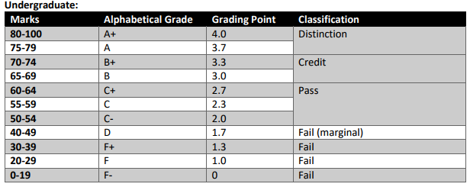
Achievement requirements

Slide 13
Question and answer session
Q & A

Slide 14
What we will cover next
Attitude
- Significance of Good attitude
- Good attitude atmosphere

